Slide 1


Slide 2




Slide 3

WEIGHTED SUBSTRING

Slide 4

TEST TIME ON QUICK, SELECTION SORT
URL: https://forms.gle/L9yNisQKr1XjdLHH9
QR CODE:

Slide 5
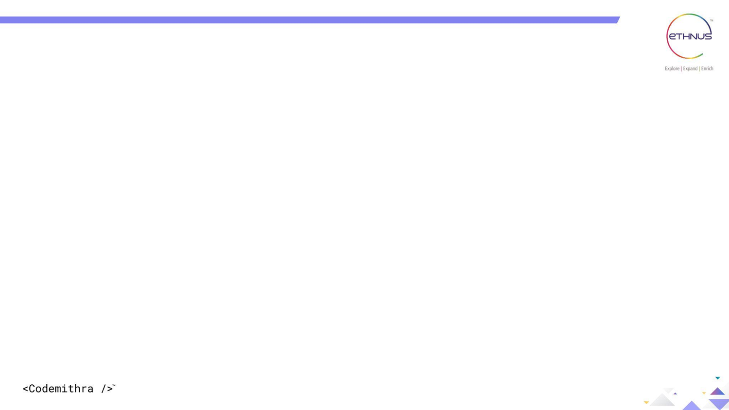
INTRODUCTION
Given a string 'P' consisting of small English letters and a string 'Q' consisting of weight of all characters of English alphabet.
Each alphabet will have a weight w where 0 <= w <= 9
The task is to find the total numbers of unique substring with sum of weights atmost K

Slide 6
WEIGHTED SUBSTRING
Weight of a string ‘s’ can be defined as ;
Weight[S[0]]
+ Weight[S[1]]
+ Weight[S[2]]
...
+ Weight[S[Len - 1]]
Where; Len is length of string

Slide 7
WEIGHTED SUBSTRING
Sample IO #1 :
Sample IO #2 :
P = “abcde”
P = “acbacbacaa”
Q = “12345678912345678912345678”
Q = “12300045600078900012345000”
k = 5
k = 2
Output =
Output = 3
Explanation :
“a”, “c”, “aa”
The idea is to use HashSet to solve it!

Slide 8
WEIGHTED SUBSTRING
Algorithm
Iterate over all the substrings using the nested loops and maintain the sum of the weight of all the characters encountered so far.
If the sum of characters is not greater than K, then insert it in a hashmap.
Finally, output the size of the hashmap.

Slide 9
WEIGHTED SUBSTRING
import java.util.*; class EthCode { static int distinctSubString(String P, String Q, int K, int N) { // Hashmap to store all subStrings HashSet < String > S = new HashSet < String > (); // Iterate over all subStrings for (int i = 0; i < N; ++i) { // Maintain the sum of all characters // encountered so far int sum = 0; // Maintain the subString till the // current position String s = ""; for (int j = i; j < N; ++j) { // Get the position of the // character in String Q int pos = P.charAt(j) - 'a'; | // Add weight to current sum sum += Q.charAt(pos) - '0'; // Add current character to subString s += P.charAt(j); // If sum of characters is <=K then insert in into the set if (sum <= K) { S.add(s); } else { break; } } } // required value return S.size(); }

Slide 10
WEIGHTED SUBSTRING
public static void main(String[] args) { //Sample Input String P = "abcde"; String Q = "12345678912345678912345678"; int K = 5; int N = P.length(); System.out.print(distinctSubString(P, Q, K, N)); } }

Slide 11
WEIGHTED SUBSTRING
Time Complexity
QuadraticTime Complexity:
O(n^n)

Slide 12
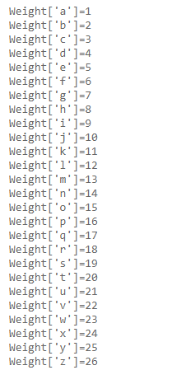
WEIGHTED SUBSTRING
This is the variation of the previous program
Given string ‘S’ which contains only lowercase characters and an integer ‘K’
Have to find number of substrings having weight equal to ‘K’
Sample IO #1 : S = “abcdef”, K=5
Output = 3
Sample IO #2 : S = “abcdef”, K=4
Output = 2

Slide 13
WEIGHTED SUBSTRING
Time Complexity
QuadraticTime Complexity:
O(n^n)

Slide 14
WEIGHTED SUBSTRING
import java.util.*; class EthCode { static int distinctSubString(String str, int K, int N) { // Hashmap to store all subStrings HashSet < String > S = new HashSet < String > (); // Iterate over all subStrings for (int i = 0; i < N; ++i) { // Maintain the sum of all characters // encountered so far int sum = 0; // Maintain the subString till the // current position String s = ""; for (int j = i; j < N; ++j) { char ch = str[j]; //Get the current weight | int currWeight = ch - 'a' int pos = P.charAt(j) - 'a'; // Add weight to current sum sum += currweight; // Add current character to subString s += P.charAt(j); // If sum of characters is ==K then insert in into the set if (sum == K) { S.add(s); } else { break; } } } // required value return S.size(); }

Slide 15
WEIGHTED SUBSTRING
public static void main(String[] args) { //Sample Input String str = "abcde"; int K = 5; //Length of the string int N = P.length(); //Sample Output System.out.print(distinctSubString(str, K, N)); } }

Slide 16
HASHSET (FOR WEIGHTED SUBSTRING)
Introduction
HashSet class is used to create a collection that uses a hash table for storage.
A Set contains unique elements only.
The underlying data structure for HashSet is Hashtable.
As it implements the Set Interface, duplicate values are not allowed.
Objects that you insert in HashSet are not guaranteed to be inserted in the same order as they are inserted based on their hash code.

Slide 17
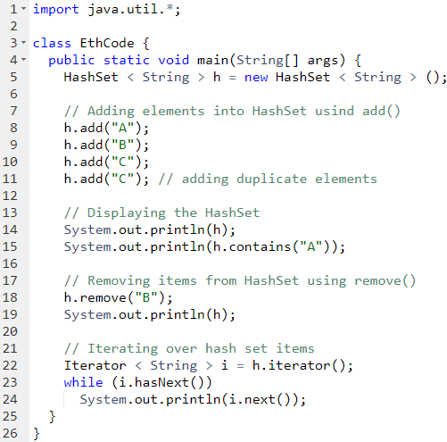
Output
[A, B, C]
true
[A,C]
A
C

Slide 18
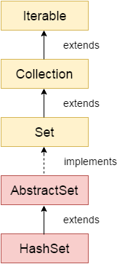

Slide 19

HashSet (For Weighted Substring)
Introduction
HashSet class is used to create a collection that uses a hash table for storage.
A Set contains unique elements only.
The underlying data structure for HashSet is Hashtable.
As it implements the Set Interface, duplicate values are not allowed.
Objects that you insert in HashSet are not guaranteed to be inserted in the same order as they are inserted based on their hash code.
Example
Output
[A, B, C]
true
[A,C]
A
C

Slide 20




THANK YOU
+91 78150 95095
codemithra@ethnus.com
www.codemithra.com

